Slide 1
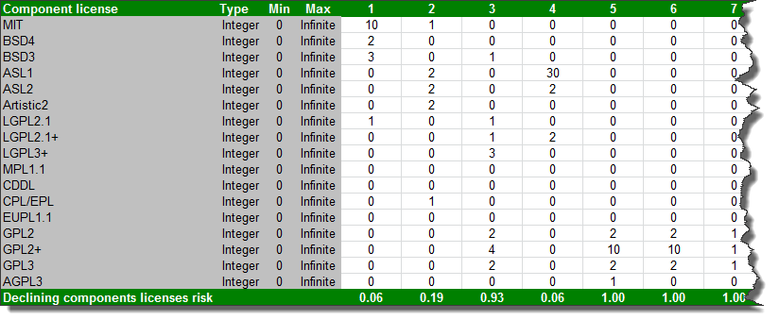
CENATIC_RISKS_PROPOSAL_DecliningComponentsLicenses.xlsx

Slide 2
An Example Based on Declining Components Licenses
Bayesian networks needed to be simplified
Cenatic data was made to fit the 3 layers methodology:
Layer I – data elements (measurements, the data on the Excel files)
Layer II – risk indicators
Layer III – risks and contextual indicators
The following steps were performed:
Split all licenses into 3 groups of statistically related licenses
Aggregate each group into an intermediate value, akin to risk indicator
Link the 3 intermediate values with the ultimate Declining Components Licenses risk
Final model has Layer II and III networks

Slide 3
An Example Based on Declining Components Licenses
Input and output levels to/from the model were determined during the creation of the Bayesian network
Input is one of 5 levels of component licenses:
0 components
1 to 2 components
3 to 9 components
10 to 19 components
20 and more components
Output is risk distribution over 4 levels:
Below 28%
28% to 44%
45% to 85%
Above 85%

Slide 4
Review Questions for Cenatic
Fitting Cenatic data into the 3 layers approach
Simplifying the model by splitting the licenses to 3 clusters
Input/output levels
Contextual indicator – are there any?

Slide 5
Declining Components Licenses
Step1
To simplify Bayesian network, performed cluster analysis on all licenses usage to identify 3 clusters: blue, red, green

Slide 6
Declining Components Licenses
Term Coef SE Coef T-Value P-Value VIF
Constant 0.5624 0.0498 11.30 0.000
MIT -0.0423 0.0132 -3.21 0.003 1.86
CPL/EPL 0.0260 0.0177 1.46 0.150 1.95
Artistic2 -0.0361 0.0308 -1.17 0.247 1.17
AGPL3 0.0304 0.0141 2.16 0.037 1.03
LGPL2.1+ 0.0045 0.0294 0.15 0.880 1.26
GPL3 0.0374 0.0140 2.68 0.010 1.22
Step2
Within each cluster, calculate individual license’s coefficient value: its relative “contribution” to the overall risk
Term Coef SE Coef T-Value P-Value VIF
Constant 0.6144 0.0504 12.19 0.000
BSD4 -0.0875 0.0350 -2.50 0.016 1.27
BSD3 -0.0607 0.0374 -1.63 0.111 2.10
LGPL3+ 0.0539 0.0269 2.01 0.051 1.94
LGPL2.1 0.0921 0.0402 2.29 0.027 1.14
CDDL -0.0327 0.0145 -2.26 0.029 1.13
EUPL1.1 -0.0059 0.0155 -0.38 0.708 1.07
Term Coef SE Coef T-Value P-Value VIF
Constant 0.6179 0.0430 14.38 0.000
ASL1 -0.02030 0.00714 -2.84 0.007 1.01
ASL2 -0.03173 0.00842 -3.77 0.000 1.04
MPL1.1 -0.0072 0.0202 -0.35 0.725 1.07
GPL2 0.0146 0.0210 0.69 0.491 1.44
GPL2+ 0.01839 0.00891 2.06 0.045 1.46

Slide 7
Declining Components Licenses
Step4
Tie everything together by linking “intermediate” values to Declining Components Licenses risk
Declining Components Licenses
Cluster 1
MIT
Cluster 2
BSD4
Cluster 3
ASL1
CPL_EPL
Artistic2
AGPL3
LGPL2_1_Plus
GPL3
BSD3
LGPL3_Plus
LGPL2_1
CDDL
EUPL1_1
ASL2
MPL1_1
GPL2
GPL2_Plus
Step3
For each cluster, calculate “cluster intermediate risk value” based on its number of licenses and their respected coefficient values

Slide 8
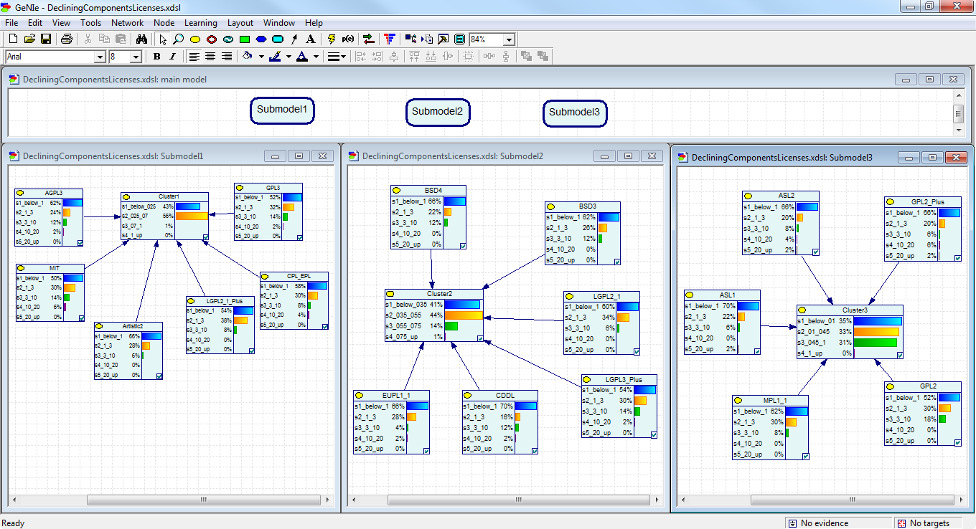
Declining Components Licenses
Layer II Bayesian Network
Comprised of 3 submodels, one per cluster

Slide 9
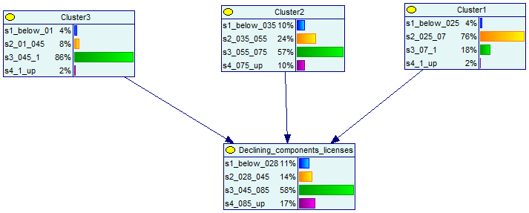
Declining Components Licenses
Layer III Bayesian Network
Risk as affected by all licenses values, as expressed by their respective “intermediate cluster risk”

Slide 10
Declining Components Licenses
Input slice (with current distribution states):
DecliningComponentsLicenses AGPL3 [ 0.6199538638985003, 0.24009996155324892, 0.11995386389850063, 0.01999231064975008, 0.0 ]
DecliningComponentsLicenses MIT [ 0.4999999999999997, 0.3000768935024993, 0.1399461745482507, 0.059976931949250335, 0.0 ]
DecliningComponentsLicenses BSD4 [ 0.6599384851980008, 0.22010765090349851, 0.11995386389850063, 0.0, 0.0 ]
DecliningComponentsLicenses BSD3 [ 0.6199538638985005, 0.26009227220299885, 0.11995386389850064, 0.0, 0.0 ]
DecliningComponentsLicenses ASL1 [ 0.6999231064975009, 0.22010765090349868, 0.05997693194925018, 0.0, 0.01999231064975007 ]
DecliningComponentsLicenses ASL2 [ 0.6599384851980009, 0.20011534025374858, 0.07996924259900026, 0.039984621299500166, 0.01999231064975008 ]
DecliningComponentsLicenses Artistic2 [ 0.6599384851980011, 0.2800845828527487, 0.05997693194925012, 0.0, 0.0 ]
DecliningComponentsLicenses LGPL2_1 [ 0.5999615532487512, 0.3400615148019985, 0.059976931949250335, 0.0, 0.0 ]
DecliningComponentsLicenses LGPL2_1_Plus [ 0.5399846212995002, 0.38004613610149934, 0.07996924259900029, 0.0, 0.0 ]
DecliningComponentsLicenses LGPL3_Plus [ 0.5399846212995005, 0.3000768935024986, 0.13994617454825067, 0.019992310649750093, 0.0 ]
DecliningComponentsLicenses MPL1_1 [ 0.6199538638985006, 0.3000768935024989, 0.07996924259900044, 0.0, 0.0 ]
DecliningComponentsLicenses CDDL [ 0.699923106497501, 0.16013071895424838, 0.11995386389850064, 0.019992310649750083, 0.0 ]
DecliningComponentsLicenses CPL_EPL [ 0.5799692425990014, 0.3000768935024982, 0.07996924259900016, 0.03998462129950009, 0.0 ]
DecliningComponentsLicenses EUPL1_1 [ 0.6599384851980007, 0.28008458285274895, 0.03998462129950022, 0.0199923106497501, 0.0 ]
DecliningComponentsLicenses GPL2 [ 0.5199923106497495, 0.3000768935024995, 0.17993079584775112, 0.0, 0.0 ]
DecliningComponentsLicenses GPL2_Plus [ 0.6599384851980009, 0.20011534025374855, 0.059976931949250176, 0.059976931949250176, 0.019992310649750083 ]
DecliningComponentsLicenses GPL3 [ 0.5199923106497498, 0.3200692041522493, 0.13994617454825076, 0.019992310649750048, 0.0 ]
CenaticRisk Contextual [ 0.5, 0.5 ]
Expected output:
CenaticRisk Declining_components_licenses
CenaticRisk Cluster1
CenaticRisk Cluster2
CenaticRisk Cluster3
Analysis output:
CenaticRisk Declining_components_licenses [ 0.3185632560170226, 0.1598142157137952, 0.5216225282691822, 0.0 ]
CenaticRisk Cluster1 [ 0.5, 0.5, 0.0, 0.0 ]
CenaticRisk Cluster2 [ 0.5, 0.5, 0.0, 0.0 ]
CenaticRisk Cluster3 [ 0.5, 0.5, 0.0, 0.0 ]
Batch mode test results
Process of Layer II & III networks
Calculated risk probabilities are:
32% probability of low risk (<28%)
16% probability of medium risk (<45%)
52% probability of high risk (<85%)
0% probability of very high risk (>85%)

